Slide 1
Quantum Computing Basics
NPTEL Course on Quantum Computing: Week 1: Module 1
Lecturer: V. Ramakrishna
Senior Researcher and Quantum Ambassador
IBM Research—India
Notes:
Welcome to the first week of the NPTEL lecture series on Quantum Computing.
I am Ramakrishna, your lecturer. I am a senior researcher and quantum ambassador at the IBM Research Lab in Bangalore.
This week we will cover the basics of quantum computing
In these modules, we will discuss ideas from quantum mechanics and mathematics that will give you a solid foundation to understand QC. The lessons you learn this week will also lay the basis for subsequent lectures, where you will understand how to develop quantum algorithms and learn to program on real quantum computers.

Slide 2
Outline
Motivation: why quantum computing
Classical computing vs quantum computing
Background: linear algebra and notation
Quantum bits or qubits
Notes:
In this module, we will be learning about the basic computation units of quantum computing, namely quantum bits or qubits.
But before diving into the concepts, we will briefly discuss why quantum computing promises to be a game changer in the field of computing, and what makes this such an exciting subject.
We will compare quantum computing to the classical computing that many of you may be very familiar with as programmers, and provide a brief background in linear algebra, which is the mathematical framework that quantum computing and algorithms are built on.
The rest of this lecture will then be devoted to qubits and their representations, both mathematically and visually.

Slide 3
Motivation: there are intrinsically hard problems that today’s computers cannot handle

Slide 4
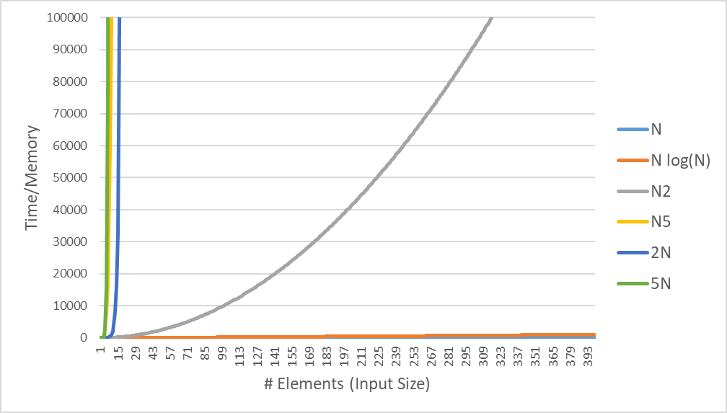
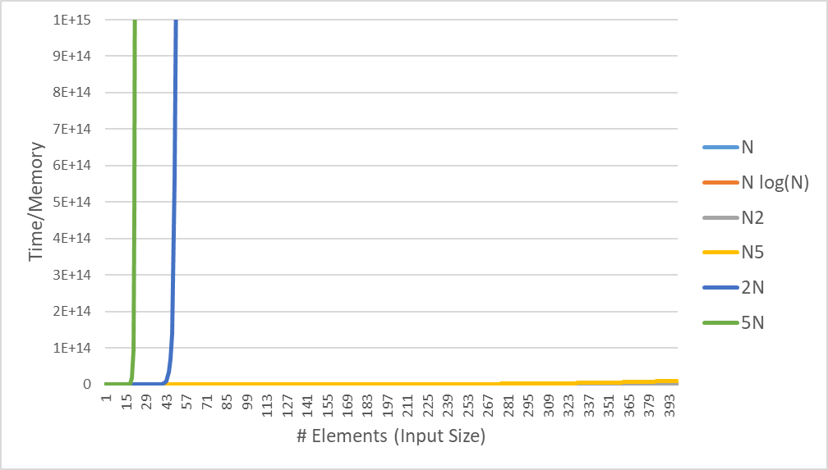
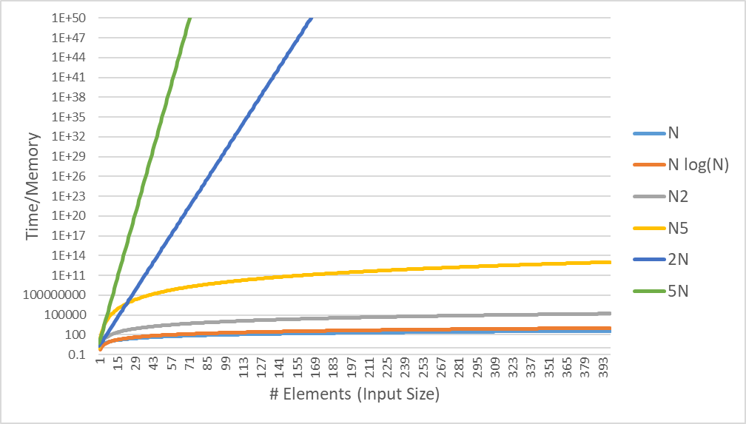
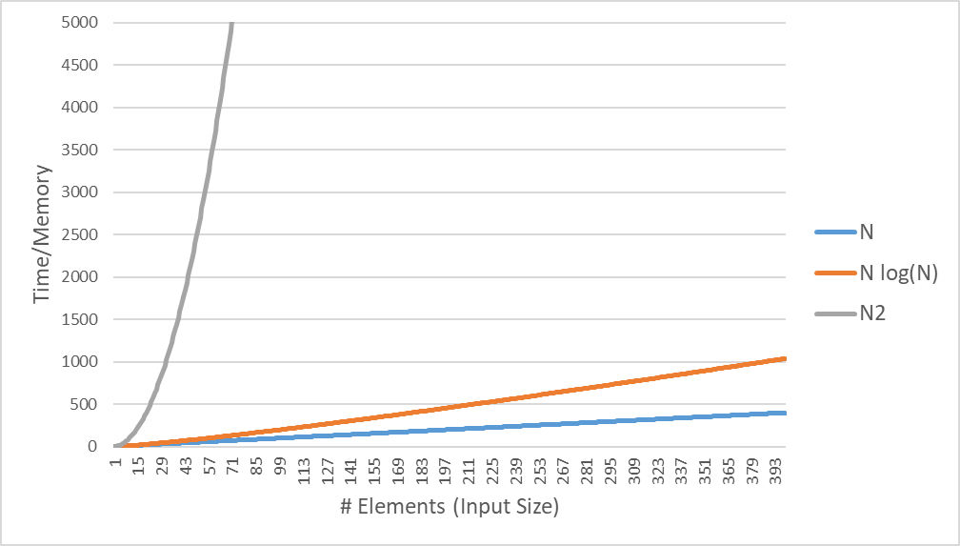
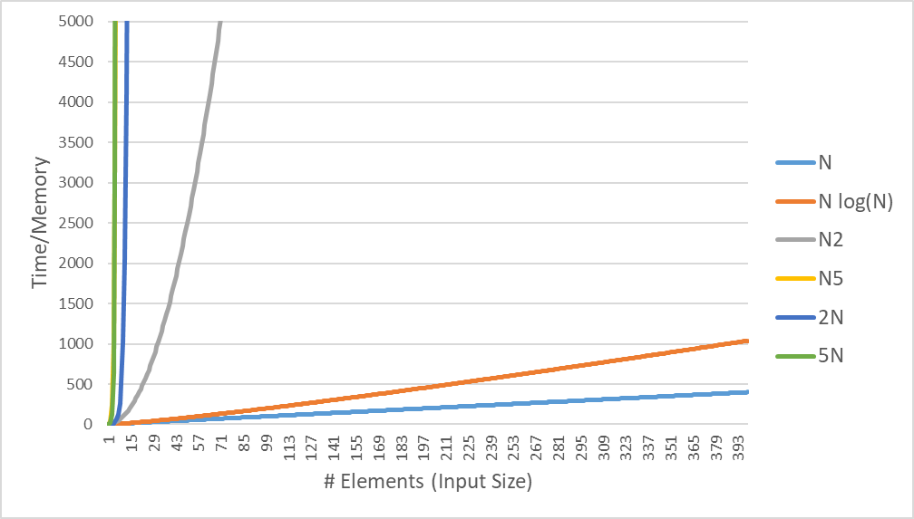
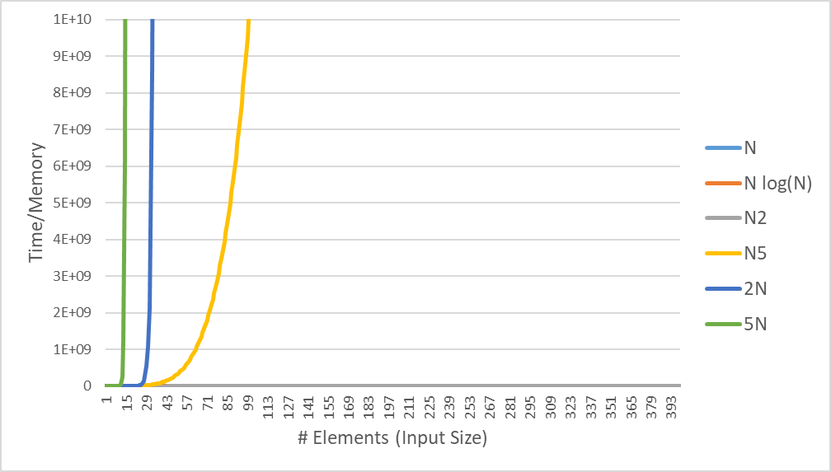
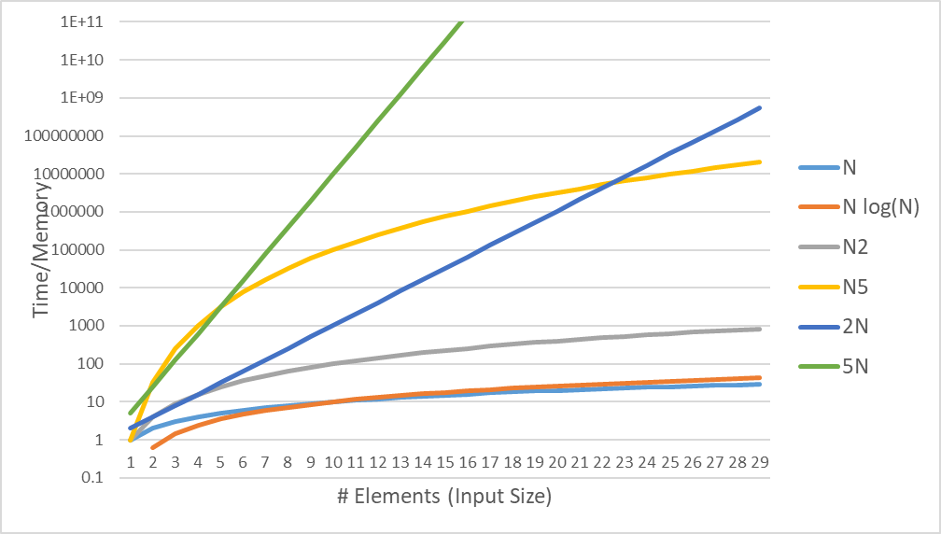
Comparing Easy and Hard Problems
Only at lower input sizes:
Polynomial growth > Exponential growth
N²
N²
N²
N²
N²
N²
N⁵
N⁵
N⁵
N⁵
N⁵
N⁵
N²
2^{N}
2^{N}
2^{N}
2^{N}
2^{N}
2^{N}
5^{N}
5^{N}
5^{N}
5^{N}
5^{N}
5^{N}
Notes:
The performance of a computer algorithm or program, as many of you may be familiar with, is measured by its complexity, which is a nothing but a function of how much time or memory is consumed by the program as the size of the input increases.
Consider the functions you see on the screen. The linear function increases fairly gently whereas that quadratic function increases at a much faster rate. NlogN, which is slower than linear but faster than quadratic, is somewhere in between.
But these are polynomial functions with low degrees. Let us compare them to polynomials of higher degree and with exponential functions.

Slide 5
Comparing Quantum Computing with Classical Computing

Slide 6


Comparing Units of Computation
Classical Computing
Quantum Computing
Bits
Qubits
Complex Numbers
0 1
α + β
b = {0, 1}
States
States
(Unit Vectors)
Superposition
(Linear Combination)
State is Deterministic
State is Probabilistic
: |α|²
: |β|²

Slide 7
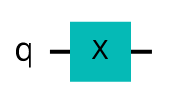




Comparing Gates and Computational Methods
Classical Computing
Quantum Computing
b
NOT Gate
Pauli-X Gate
Boolean Algebra
Linear Algebra
NOT 0 = 1
NOT 1 = 0
$$X\left(α\left.|0\right\rangle +β\left.|1\right\rangle \right)=β\left.|0\right\rangle +α\left.|1\right\rangle$$

Slide 8
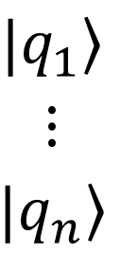
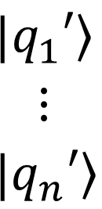
Comparing Gates and Computational Methods
Classical Computing
Quantum Computing
AND Gate
$$\left.|q_{1}\right\rangle$$
$$⋮$$
$$\left.|q_{n}\right\rangle$$
A
$$\left.|q_{1}′\right\rangle$$
$$⋮$$
$$\left.|q_{n}′\right\rangle$$
b₁
b_{out}
b₂
×
✓
Operation irreversible
Operation reversible
State Space Size: N
Linear in size of input
State Space Size: 2^{N}
Exponential in size of input

Slide 9
Quantum Computing Basics

Slide 10

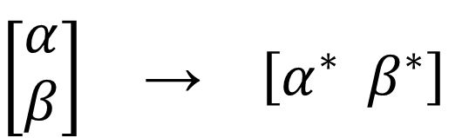
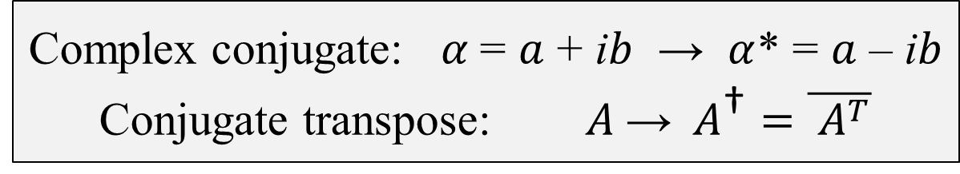

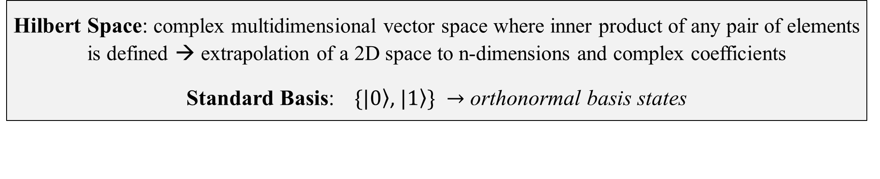




Notation
Dirac (Bra-Ket) Notation
Vectors
Matrix (Linear Algebra)
Orthogonal unit vectors
$\left.|0\right\rangle$ $\left.|1\right\rangle$
$$\hat{i} \hat{j}$$
ket
Complex Numbers
$$\left.|ψ\right\rangle = α\left.|0\right\rangle +β\left.|1\right\rangle$$
$$α\hat{i}+β\hat{j}$$
$$\left[\begin{aligned}α \\ β\end{aligned}\right]$$
Element in a complex Hilbert (vector) space
bra
⟨0|
⟨1|
conjugate transpose of a ket
Linear combination of orthonormal basis states
$$\left[\begin{aligned}α \\ β\end{aligned}\right] \text{→} \left[α^{∗}{ β}^{∗}\right]$$
Hilbert Space: complex multidimensional vector space where inner product of any pair of elements is defined → extrapolation of a 2D space to n-dimensions and complex coefficients
Standard Basis: $\left.\{|0\right\rangle$,$\left.|1\right\rangle \} →$ orthonormal basis states
Complex conjugate: $α$= $a$ + i$b$ → $α$* = $a$ – i$b$
Conjugate transpose: $A \text{→} A^{\text{†}}=\overline{ A^{T}}$
ket
(column vector)
bra
(row vector)
Notes:
Mention orthonormal basis states (and standard basis). - DONE
Define Hilbert space: complex multidimensional space where inner product is defined. - DONE
Dirac notation, vector equivalent, ket, bra.
Mention why we are using the term basis states for |0> and |1>; because they are orthonormal bases in a complex 2D vector space.
Think of the bra as a function or an operator.

Slide 11
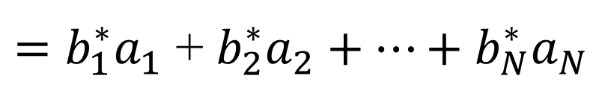
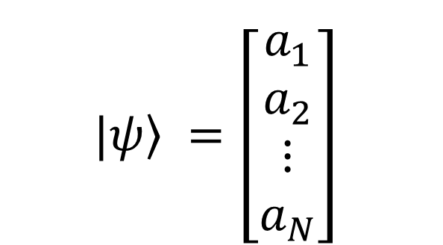
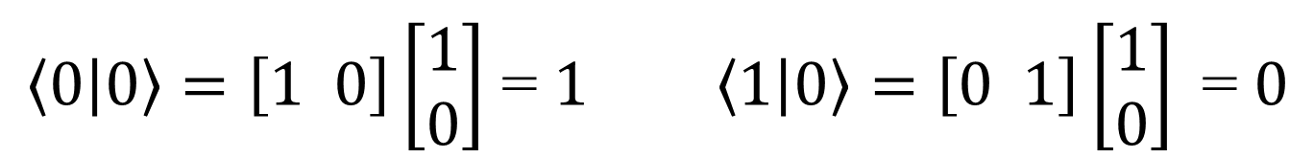
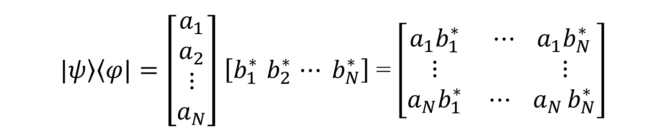



Notation (continued)
$$\left.|ψ\right\rangle =\left[\begin{aligned}a_{1} \\ a_{2} \\ ⋮ \\ a_{N}\end{aligned}\right]$$
bra
$$\left\langle φ|\right. =\left[b_{1}^{∗}{ b}_{2}^{∗} ⋯ b_{N}^{∗}\right]$$
ket
$$=\left[b_{1}^{∗}{ b}_{2}^{∗} ⋯ b_{N}^{∗}\right]\left[\begin{aligned}a_{1} \\ a_{2} \\ ⋮ \\ a_{N}\end{aligned}\right]$$
$\left\langle 0 | 0\right\rangle =\left[1 0\right]\left[\begin{aligned}1 \\ 0\end{aligned}\right]$ = $1 \left\langle 1 | 0\right\rangle =\left[0 1\right]\left[\begin{aligned}1 \\ 0\end{aligned}\right]\text{ = }0$
bra-ket
$$\left\langle φ | ψ\right\rangle$$
$=b_{1}^{∗}a_{1}$ + $b_{2}^{∗}a_{2}+⋯+b_{N}^{∗}a_{N}$
Inner product (single complex number)
like vector dot product
$\left.|ψ\right\rangle \left\langle φ|\right.=\left[\begin{aligned}a_{1} \\ a_{2} \\ ⋮ \\ a_{N}\end{aligned}\right]$ $\left[b_{1}^{∗}{ b}_{2}^{∗} ⋯ b_{N}^{∗}\right]$ = $\left[\begin{matrix}a_{1}b_{1}^{∗} & ⋯ a_{1}b_{N}^{∗} \\ \begin{aligned}⋮ \\ a_{N}b_{1}^{∗}\end{aligned} & \begin{aligned} ⋮ \\ {⋯ a}_{N}b_{N}^{∗}\end{aligned}\end{matrix}\right]$
ket-bra
Outer product (N-by-N matrix) linear transformation operator
Notes:
Mention orthonormal basis states (and standard basis). 0 and 1 are bases for a vector space. – DONE in previous slide
Inner product (bra-ket), outer product (ket-bra)
Discuss inner product of orthogonal vectors (is zero) while identical vectors is 1.
The bra-ket is an operation to map a ket to a scalar.
The ket-bra is an operator for linear transformations, to map one ket to another. This will come in handy as you will see in a later module.

Slide 12
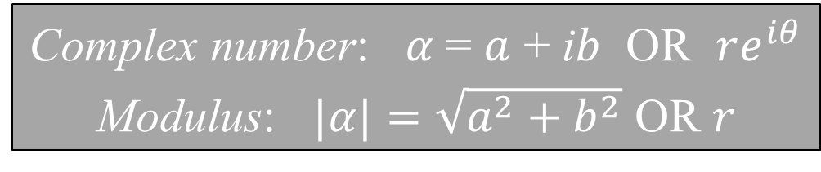

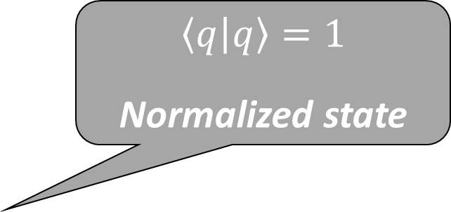
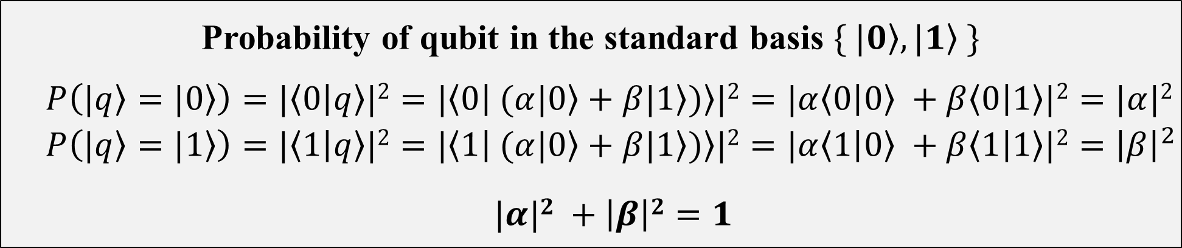
Single Qubits
A vector in complex two-dimensional Hilbert space
General qubit state (state vector)
$\left.|q\right\rangle = α\left.|0\right\rangle +β\left.|1\right\rangle α,β ∈ ℂ$
Probabilities summing to 1 follows from Quantum physical requirements
𝛼 and 𝛽 are probability amplitudes
$$\left[\begin{aligned}α \\ β\end{aligned}\right]$$
Complex number: $α$= $a$ + i$b$ OR $re^{iθ}$
Modulus: $|α|=\sqrt{a^{2}+b^{2}}$ OR $r$
Orthonormal basis states (Inner product = 0)
Qubit probabilistically collapses to a basis state
Probability of qubit in the standard basis $\{ \left.|0\right\rangle , \left.|1\right\rangle \}$
$$P\left(\left.|q\right\rangle =\left.|0\right\rangle \right)=|\left\langle 0 | q\right\rangle |2=|\left\langle 0 | (α\left.|0\right\rangle +β\left.|1\right\rangle )\right\rangle |2=|α\left\langle 0 | 0\right\rangle +β\left\langle 0 | 1\right\rangle |2=|α|2$$
$$P\left(\left.|q\right\rangle =\left.|1\right\rangle \right)=|\left\langle 1 | q\right\rangle |2=|\left\langle 1 | (α\left.|0\right\rangle +β\left.|1\right\rangle )\right\rangle |2=|α\left\langle 1 | 0\right\rangle +β\left\langle 1 | 1\right\rangle |2={\left|β\right|}^{2}$$
$|α|2$ $+ \left|β\right|2=1$
$$\left\langle q | q\right\rangle =1$$
Normalized state
Notes:
Sum of coefficients-squared adds to 1 (because of probabilities): comes from physical requirement (Prabha’s lecture) - DONE
Don’t mention the word “measurement” at all here; say “probability of qubit being in either basis state”. - DONE
Alpha, beta are not probabilities; they are probability amplitudes (put in slide). - DONE
Mathematical representation
Orthogonal basis states: |0>, |1>. Inner product is zero. Vector representations, matrix representation
Talk about measurement and normalization
Born rule

Slide 13
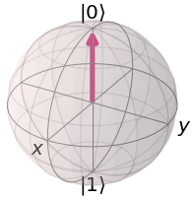
Qubit Representation
Bloch Sphere
Z-axis
Y-axis
X-axis
Notes:
Visual representation (Bloch sphere)

Slide 14
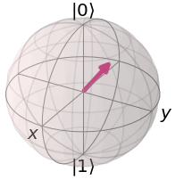
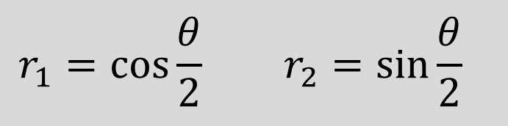


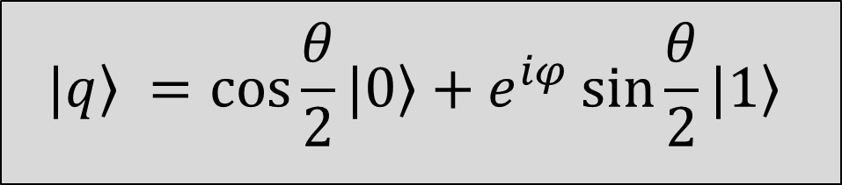

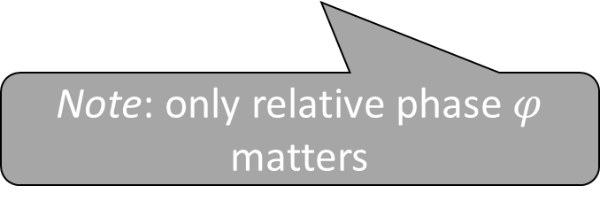


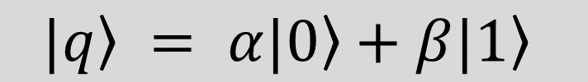
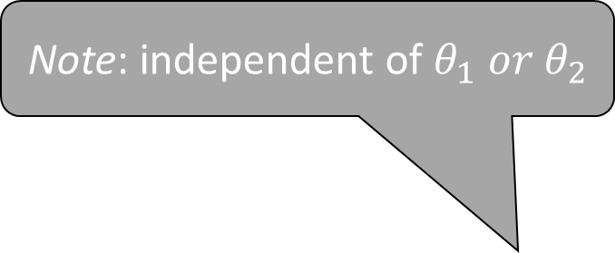

Qubit Representation
Note: angle between qubit and basis vectors twice as large as in Hilbert space
$$\left.|q\right\rangle = α\left.|0\right\rangle +β\left.|1\right\rangle$$
Note: independent of $θ_{1} or{ θ}_{2}$
$$α=r_{1}e^{iθ_{1}} β=r_{2}e^{iθ_{2}}$$
$$θ$$
$$\left.|q\right\rangle$$
$$r_{1}2 + r_{2}2 =1$$
$$r_{1}=\cos{\frac{θ}{2} }r_{2}=\sin{\frac{θ}{2}}{ }$$
$$φ$$
$$θ_{2}=θ_{1}+φ$$
Qubit relative phase (rotation around Z-axis) has no analogue in classical computing (like superposition)
$$\left.|q\right\rangle =\cos{\frac{θ}{2}}\left.|0\right\rangle +e^{iφ}\sin{\frac{θ}{2}}\left.|1\right\rangle$$
Note: only relative phase $φ$ matters
Notes:
Visual representation (Bloch sphere)
Bloch vector, angles twice as large in Bloch sphere as in Hilbert space
Mention that phase rotation, just like superposition, has no analogue in classical computing - DONE
Relative phase: difference in phase between the 0 and 1 basis vectors.
We can choose how to orient our sphere, or set its frame of reference, and every qubit will be positioned relative to the sphere’s orientation.
You will understand more about the Bloch sphere and the quantum physical intuition behind the angles in a qubit representation in subsequent modules.
Exercise: determine (X,Y,Z) coordinates for $\left.|q\right\rangle$ in terms of $θ$ and $φ$

Slide 15
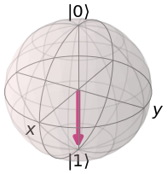
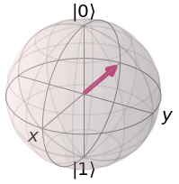
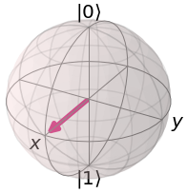
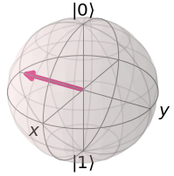
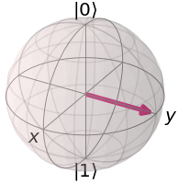
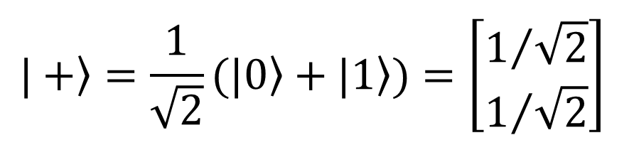
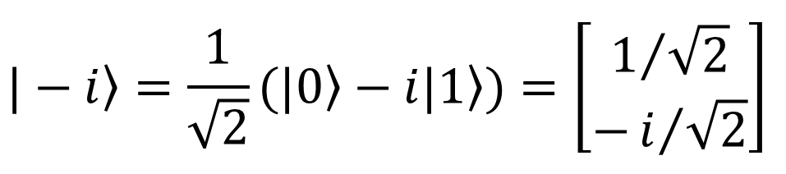
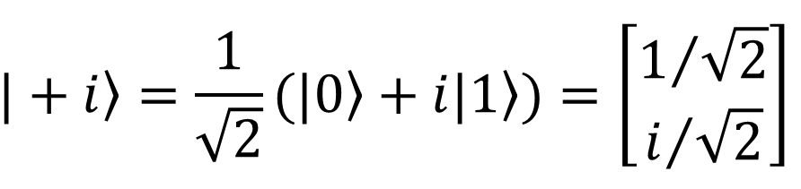

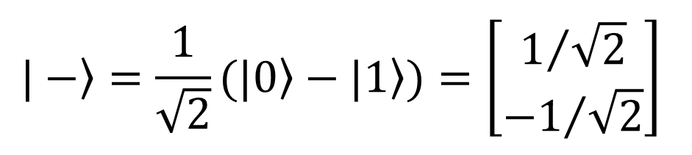

Notable Examples of Single Qubits
$$\left.|0\right\rangle =\left[\begin{aligned}1 \\ 0\end{aligned}\right]$$
$$\left.|1\right\rangle =\left[\begin{aligned}0 \\ 1\end{aligned}\right]$$
$$\left.|+\right\rangle =\frac{1}{\sqrt{2}}\left.(|0\right\rangle +\left.|1\right\rangle )=\left[\begin{aligned}1/{\sqrt{2}} \\ 1/{\sqrt{2}}\end{aligned}\right]$$
$$\left.|−\right\rangle =\frac{1}{\sqrt{2}}\left.(|0\right\rangle −\left.|1\right\rangle )=\left[\begin{aligned}1/{\sqrt{2}} \\ {−1}/{\sqrt{2}}\end{aligned}\right]$$
$$\left.|+i\right\rangle =\frac{1}{\sqrt{2}}\left.(|0\right\rangle +\left.i|1\right\rangle )=\left[\begin{aligned}1/{\sqrt{2}} \\ i/{\sqrt{2}}\end{aligned}\right]$$
$$\left.|−i\right\rangle =\frac{1}{\sqrt{2}}\left.(|0\right\rangle −\left.i|1\right\rangle )=\left[\begin{aligned}1/{\sqrt{2}} \\ −i/{\sqrt{2}}\end{aligned}\right]$$
Notes:
END here: this was abstract mathematical representation; for the physical intuition (or physical basis; QM), Prabha will continue. (Put a title chart; what’s the physical basis?)
0,1 +- i,-I
Talk about: Z-measurement is what we do. X-measurement is equivalent mathematically but not possible physically.

Slide 16
Summary and Preview of Next Lesson
Thus far, you have learned about
The key differences between quantum and classical computing
Qubits, the linear algebraic concepts underlying them, and their visual representations
Next, you will learn about
The quantum physical basis of qubits, more mathematical details about quantum states and basis states, and measurements of quantum superposition states
Notes:
Replace with “Next, we’ll demonstrate all the qubit gates and circuits in practice, using IBM-Q and Qiskit.”

